Slide 1
Malassezia pachydermatis
Dr. Bincy Joseph
Assistant professor
PGIVER, Jaipur

Slide 2

Malassezia pachydermatis
Bottle-shaped cells of the yeast, Malassezia pachydermatis.
Monopolar budding on a broad base, with the formation of a
prominent collarette, is a characteristic of this yeast.

Slide 3
Pathogenesis and pathogenicity
The yeast cells induce excessive sebaceous secretion, a feature of seborrhoeic dermatitis
Zymogens in the yeast cell wall can activate the complement cascade leading to damage to keratinocytes, inflammation and pruritus.
In otitis externa, the production of proteolytic enzymes by M. pachydermatis results in damage to the mucosa of the ear
canal
Excessive production and retention of wax, a consequence of ceruminous gland hypersecretion
Inflammatory exudate and necrotic debris accumulate in the canal.

Slide 4
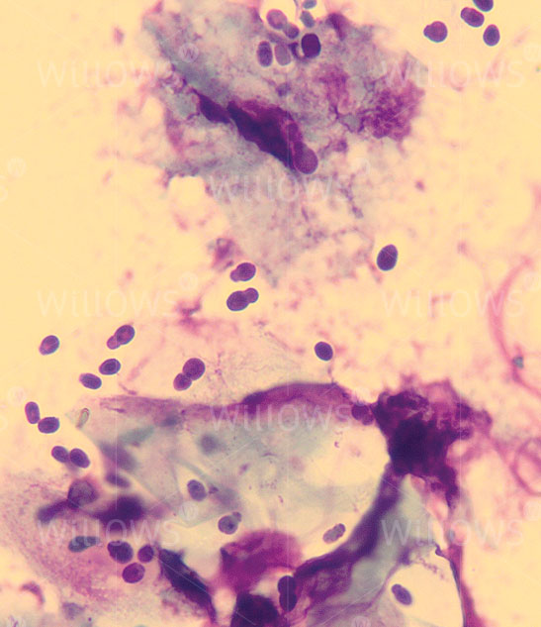
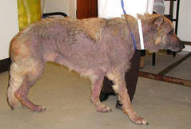
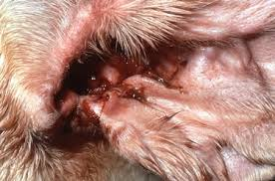

Slide 5
DIAGNOSIS
Clinical signs of otitis externa and canine seborrhoeic dermatitis
Exudates from affected ear canals and skin scraping or impression smear can be collected as samples
Yeast cells are stained with methylene blue
Culture of the yeast aerobically at 37º C 3-4 days in Sabouraud dextrose agar
Dixon’s agar, a lipid- supplemented agar, supports the
growth of both M. pachydermatis and the lipid-dependent Malassezia species.

Slide 6
Identification of species
Colonial appearance
Growth without lipid supplementation
Characteristic microscopic appearance
PCR

Slide 7
Treatment
miconazole–chlorhexidine shampoo
topical and oral ketoconazole

Slide 8
Dimorphic Fungi
Dimorphic fungi, occur in two distinct forms, a mould form and a yeast form.
They exist as moulds in the environment and when cultured on Sabouraud dextrose agar at 25°Cto 30°C.
In animal tissues and when cultured at 37°C on brain– heart infusion agar with the addition of 5% blood, most grow as yeasts
The dimorphic fungi most often associated with disease in domestic animals are
Blastomyces dermatitidis,
Histoplasma capsulatum
Coccidioides immitis

Slide 9
Blastomyces dermatitidis
causes blastomycosis, mainly in dogs and humans.
present in moist, acid soils rich in organic matter
Blastomycosis most commonly affects dogs and humans .
Infection usually occurs by inhalation of aerosolized spores or mycelial fragments
Virulence factor is BAD1 (Blastomuces adhesin)
Mainly pulmonary infecton which can spread to skin, eyes and bone , when the cell mediated immunity is weak

Slide 10
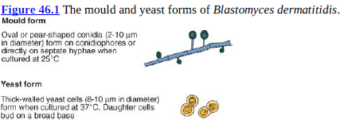

Slide 11
Diagnosis
When incubated at 25°C to 30°C on Sabouraud dextrose agar, mould colonies are white and
cottony, usually becoming brown with age. Oval or pear-shaped conidia (2 to 10 μm in diameter)
are borne either on conidiophores or directly on the hyphae.
When incubated at 37°C on brain–heart infusion agar with added cysteine and 5% blood, yeast
colonies are cream to tan, wrinkled and waxy. The yeast cells (8 to 10 |m in diameter) are thick w alled
and typically bud on a broad base.
A soluble exoantigen of B. dermatitidis can be identified by agar gel immunodiffusion using
specific antiserum
nucleic acid probes for use on cultures of dimorphic fungi
Yeast cells may be demonstrated in cytological and histopathological preparations from affected
tissues by staining with the PAS stain or with methenamine silver.

Slide 12
Exudates or aspirates for cytological examination should be stained with methylene blue or by the Giemsa method.
Alternatively, immunofluorescent staining can be used to specifically identify the yeast form in
tissues.
Polymerase chain reaction
Serological procedures, suitable for demonstrating rising antibody titres in affected dogs, are
ELISA and counter- immunoelectrophoresis.
Detection of fungal antigen in serum and urine by enzyme immunoassay

Slide 13
Histoplasma capsulatum
Histoplasma capsulatum var. capsulatum (H.
capsulatum), which can produce systemic histoplasmosis mainly in dogs and cats
H. capsulatum var. farciminosum (H. farciminosum) which causes equine epizootic lymphangitis
found in soil, particularly when enriched with bird or bat faeces

Slide 14
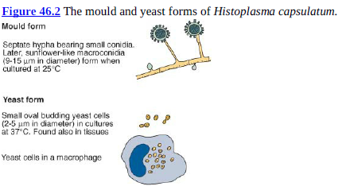

Slide 15
Canine and Feline Histoplasmosis
Following inhalation, microconidia are ingested by pulmonary alveolar macrophages, in which the yeast forms persist and replicate.
Granulomatous lesions may be found in the lungs of both dogs and cats. Disseminated disease has been recorded in both species, probably associated with impaired cell mediated immunity.
In dogs, ulcerative intestinal lesions are commonly encountered whereas intestinal involvement is rare in cats.
Clinical signs in affected dogs include chronic cough, persistent diarrhoea and emaciation.
Less frequently, peripheral lymphadenitis, ulcerative skin nodules, eye lesions, lameness and neurological dysfunction may be encountered. T
The clinical signs in cats relate mainly to pulmonary involvement and include dyspnoea, depression, fever and loss of weight. Disseminated histoplasmosis is invariably fatal.
Itraconazole is the drug of choice on account of its low toxicity.

Slide 16
Epizootic lymphangitis
Epizootic lymphangitis, caused by H. farciminosum, is a contagious disease of Equidae
Infection is usually acquired from environmental sources through minor skin abrasions on the limbs.
primary ocular involvement and pulmonary involvement have also been recorded.
Characteristic lymphocutaneous lesions, which resemble those of equine farcy consist of ulcerated discharging nodules usually located along the course of thickened, hard, lymphatic vessels.
Regional lymphadenopathy is often present. Yeast cells of H. farciminosum are found in large numbers in lesions, mainly within macrophages
Histoplasma farciminosum, present in discharges, can be spread by biting insects and through contaminated grooming gear and harness.

Slide 17
Diagnosis
When cultured at 25°C to 30°C on Sabouraud dextrose agar, the mould form grows as white to buff colonies with cottony aerial hyphae.
Septate hyphae bear small conidia. In mature colonies, slender conidiophores produce tuberculate, sunflower-like macroconidia (9 to 15 μm in diameter).
When cultured at 37°C on brain–heart infusion agar with added cysteine and 5% blood, yeast
colonies are round, mucoid and cream-coloured. Budding yeast cells are oval to spherical (2 to 5 μm in diameter).
nucleic acid probe can be used for identification of isolates
Giemsa-stained smears of exudates or aspirates may be used for demonstrating yeast forms in macrophages.
Histopathological examination of affected tissues reveals pyogranulomatous foci containing yeast forms.
Molecular techniques can be used to detect the fungal DNA in histological sections
A positive skin test, using histoplasmin, merely indicates exposure to the fungus.

Slide 18
Coccidioides immitis
The geophilic fungus C. immitis can infect a wide range of animal species including humans.
Coccidioides immitis grows in the soil of arid or semiarid areas
Although grouped with the dimorphic fungi, C. immitis is biphasic rather than dimorphic because typical yeast forms are not produced.
Large spherules containing endospores develop in tissues.
Respiratory infections may follow inhalation of arthroconidia (arthrospores) produced from the mould form of the fungus in soil

Slide 19
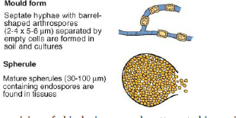
Coccidioides immitis

Slide 20
Following inhalation, the arthrospore is stimulated by the presence of phagocytes, increased CO2 and 37°C to differentiate into a multinucleated spherule which then reproduces by endosporulation.
Upon maturation, the spherule ruptures releasing hundreds of endospores that can mature into new spherules in the surrounding tissues.
The large size of the spherule may allow it to avoid engulfment by phagocytes.
The tissue damage caused is thought to be the result of a combination of enzymatic activity and the host’s immunological response
Osteomyelitis and pulmonary lesions

Slide 21
Diagnosis
When cultured on Sabouraud dextrose agar at 25°C to 30°C, colonies are shiny, moist and grey, becoming white and cottony. Thick-walled, barrel-shaped arthroconidia, separated by empty cells which undergo degeneration, are released following hyphal fragmentation
The identity of suspect cultures can be confirmed using aqueous extracts in immunodiffusion tests with specific C. immitis antiserum.
A commercially available nucleic acid probe can be used on cultures for identification
The history may indicate that a suspect animal came from an endemic area.
Radiographs of the thorax or affected limbs may detect lesions consistent with coccidioidomycosis.
Spherules of Coccidioides species may be demonstrated in exudates or aspirates cleared with
10% KOH and may also be identified in stained tissue sections.
Complement fixation, agar gel immunodiffusion, ELISA and latex agglutination tests can be employed to demonstrate rising antibody titres.
A positive skin test, using a filtrate of a mycelial culture (coccidioidin), is indicative of exposure to the fungus.
Intraperitoneal inoculation of mice with material from cultures may be necessary to demonstrate the formation of spherules in vivo.

Slide 22
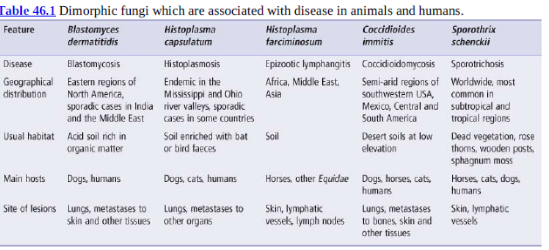

Slide 23
Rhinosporidium seeberi
Rhinosporidium seeberi is a fungus-like organism which has not been cultured on inert media but has been maintained in monolayers of human rectal tumour cells
Rhinosporidiosis, a sporadic, non-contagious, pyogranulomatous infection of the skin or mucosa, has been recorded in horses, dogs, cattle, goats, waterfowl and humans.
Cases occur predominantly in tropical and subtropical regions, particularly in Sri Lanka, southern India and Argentina

Slide 24
It is generally considered that stagnant water and possibly soil are the natural habitats of the organism
Rhinosporidium seeberi is of low pathogenic potential and disseminated infection is rare
The life cycle of the organism is uncertain
Rhinosporidiosis presents most commonly as a chronic polypous rhinitis characterized by the presence of large sporangia (100 to 400 μm in diameter) in affected tissues
The sporangia, which have double-contoured cell walls with an outer chitinous layer and an inner layer of cellulose, contain up to 16,000 endospores (approximately 7 μm in diameter)
Mature endospores can be stained by the PAS and methenamine silver methods
Several electron-dense bodies (1.5 to 2.0μm in diameter) containing DNA are present in the endospores

Slide 25
The polyps, which may be sessile or pedunculated and up to 3cm in diameter, are composed of soft
fibromyxomatous stromal tissue covered by epithelium
Mature sporangia may be detectable grossly
in the stroma as minute white spots
Cellular response to sporangia is sparse except when they rupture.
The release of endospores elicits a marked pyogranulomatous reaction

Slide 26
The reddish brown polyps in rhinosporidiosis may project from the nares and can occlude the nasal passages
Noisy breathing may be exacerbated by exercise
Nasal discharge is usually present and epistaxis may occur.
cryosurgery or electrocauterization is suggested to avoid excessive bleeding
Diaminodiphenylsulphone(dapsone)

Slide 27
Diagnosis
Nasal polyposis may suggest the presence of the condition.
Specimens for laboratory examination should include biopsy material and scrapings from lesions.
Cytological examination demonstrates a neutrophilic response and many endospores.
Neutrophils form aggregates around endospores.
Sporangia can be demonstrated histologically in tissue sections.

